Slide 1
Chapter 3-2
Digital Transmission

Slide 2
Topics
Digital to digital conversion
Analogue-to digital conversion
Transmission mode

Slide 3
Digital Transmission
Transmission of digital signal through the channel is called digital transmission.
Data
Digital
Analog
Signals
Digital
Analog

Slide 4
Digital Transmission
Digital data , Digital Signals
The simplest form of encoding of digital data is to assign one voltage level to binary one and another voltage level to the binary zero.
More complex encoding schemes are used to improve performance by altering the spectrum of the signal and providing synchronization capability
Analog data, digital signals
Analog data such as voice and video are often digitized to be able to use digital transmission facilities. The simplest technique is PCM which involves sampling analogue data periodically and quantizing the sample.

Slide 5
DIGITAL-TO-DIGITAL CONVERSION
Some characteristice
Signal Element V.s Data Element
Data Rate V.s Signal Rate
Bandwidth
Baseline Wandering
DC Components
Self-synchronization
Built-in Error Detection
Complexity

Slide 6
term | Unit | Definition
Data element | bit | A single (binary one or zero) entity that can represent a piece of information
Data rate /Bit Rate | Bits per second (bps) | The number of data elements sent in 1s.
Signal element | Digital : a voltage pulse of constant amplitude Analogue: a pulse of constant frequency phase and amplitude | That part of a signal that occupies the shortest interval of the signaling code. The shortest unit (time wise) of a digital signal
Signaling rate/modulation rate /pulse rate/baud rate | Signal element per second (baud) | the number if signal elements sent in is.

Slide 7
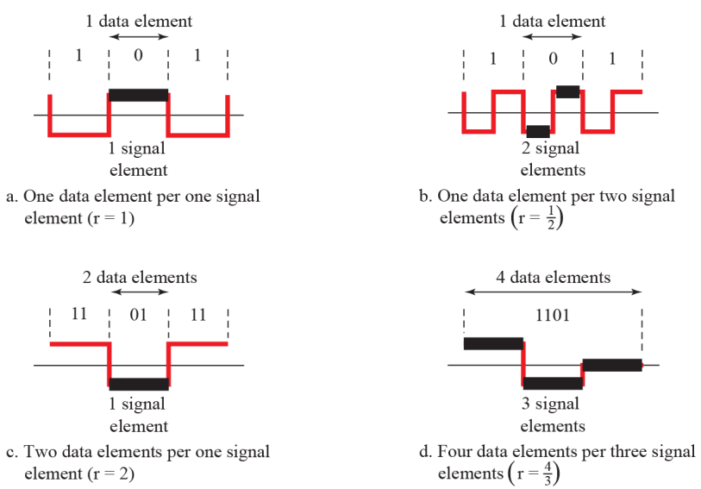

Slide 8
DC component
Residual Direct Current(DC) components or zero frequencies are undesirable
Some systems do not allow passage of DC component (such as a transformer) may distort the signal and create output errors
Dc components is extra energy residing on the line and is useless

Slide 9
Self-synchronization
Digital signal includes timing information in the data being transmitted to prevent miss interpretation
Receiver setting the clock matching the sender’s

Slide 10
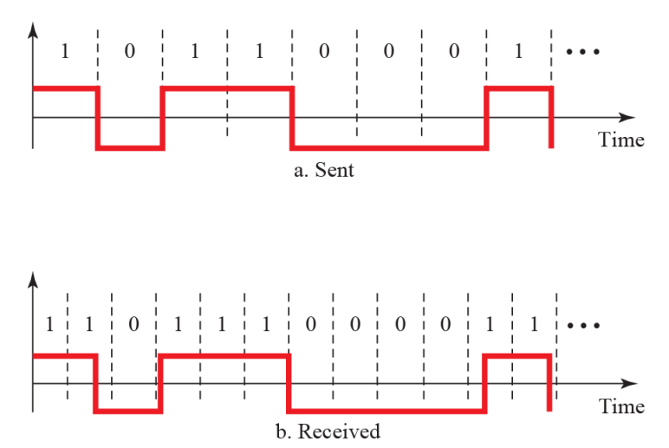
Effect of lack of synchronization

Slide 11
DIGITAL-TO-DIGITAL CONVERSION
Three techniques to convert digital data to digital signal.
line coding
block coding
scrambling
Line coding is always needed; block coding and scrambling may or may not be needed

Slide 12
three techniques to convert digital data to digital signal.
line coding
block coding
scrambling
Line coding is always needed; block coding and scrambling may or may not be needed.

Slide 13
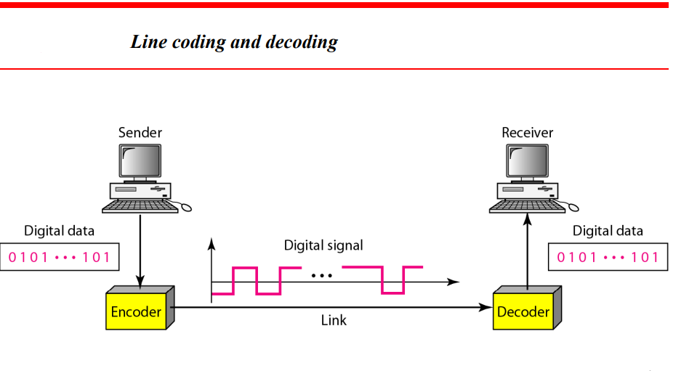
Line coding
Line coding is the process of converting digital data to digital signal

Slide 14
One goal in data communications is to increase the data rate while decreasing the signal rate.
Increasing the data rate increases the speed of transmission; decreasing the signal rate decreases the bandwidth requirement.

Slide 15
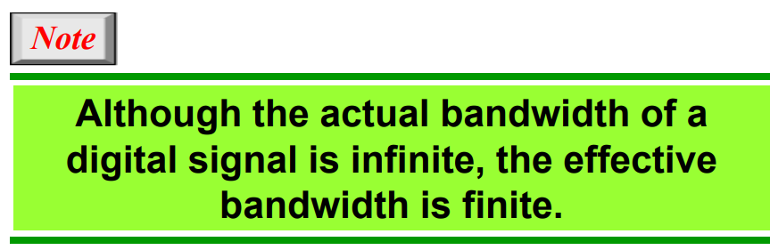

Slide 16
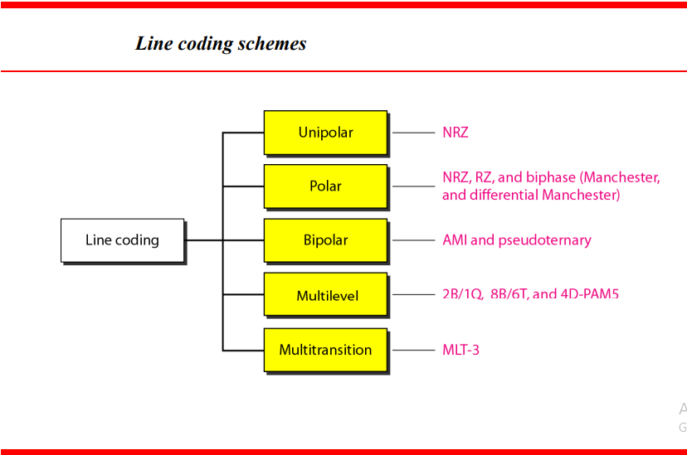

Slide 17
Unipolar
Simplest method ; inexpensive
Uses only one voltage level
Polarity(+ or-) is usually assigned to binary 1 and a 0 is represented by zero voltage.
Potential problems
DC component
Lack of synchronization

Slide 18
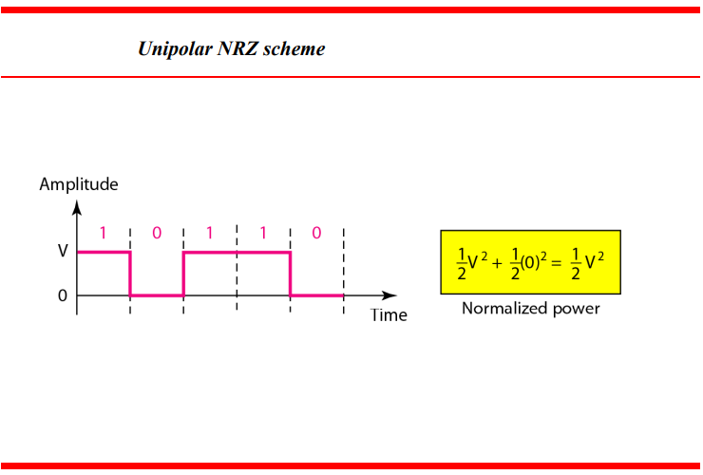
Unipolar Non Return to Zero(NRZ)
Unipolar - All signal elements have the same sign
It is called NRZ because the signal does not return to zero at the middle of the bit.

Slide 19
Polar
Uses two voltage levels, one positive and one negative
Alleviates DC component

Slide 20
Non Return to Zero (Polar NRZ)
It uses two different voltage levels(positive or negative) to represent binary values.
It is also NRZ because there is no rest condition.
NRZ scheme has two variants:
NRZ-L(NRZ-Level)
NRZ-I(NRZ-Inverted)

Slide 21
NRZ-L(NRZ-Level)
Sign level depends on bit represented
0- high level(positive)
1- low level(negative)
voltage is constant during bit interval
Problem : synchronization of long streams of 0s an 1s.

Slide 22
NRZ-I(NRZ-Inverted)
Inversion of voltage represents 1 → transition (low to high or high to low) at the beginning of the interval.
0- no transition at the beginning of the interval (one bit time)
constant voltage pulse for duration of bit
Allows for synchronization.

Slide 23
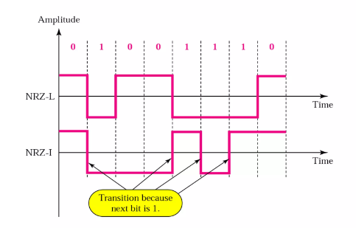
NRZ-L changes voltage level when a different bit is encountered whereas NRZ-I changes voltage when a 1 is encountered.

Slide 24
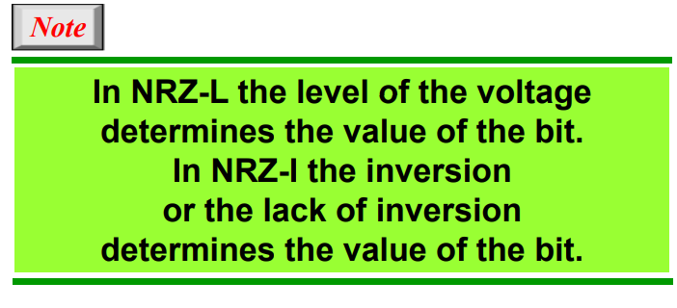

Slide 25
Return to Zero(RZ)
uses three voltage levels: positive, negative and zero
1 bit is represented by positive-to-zero
0 bit is represented by negative -to-zero
zero voltage for none.
Signals change during bits not between bits.

Slide 26
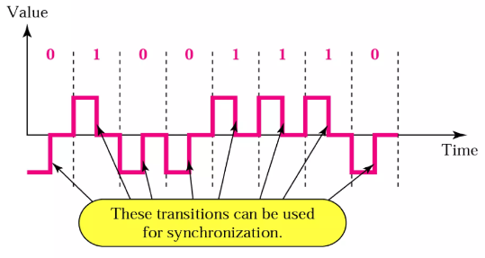

Slide 27
Manchester
This encoding scheme is a combination of RZ and NRZ-L.
Uses an inversion at the middle of each bit interval for both synchronization and bit representation(transition serves as clock and data
Bit time is divided into two halves. It transits in the middle of the bit and changes phase when a different bit is encountered.
1- transition from low to high(negative-to-positive) in the middle of the interval
0- transition from high to low (positive –to negative)in the middle of the interval

Slide 28
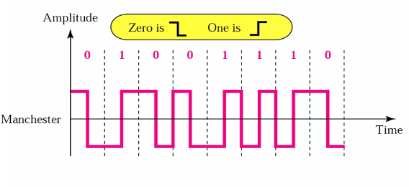

Slide 29
Differential Manchester
This encoding scheme is a combination of RZ and NRZ-I.
Always a transition in the middle of the bit interval but changes phase only when 1 is encountered.
Mid bit transition(inversion ) is used clocking (synchronization) only
transition at start of bit period representing 0
no transition at start of bit period representing 1
Requires two signal changes to represent binary 0 but only one to represent 1.

Slide 30
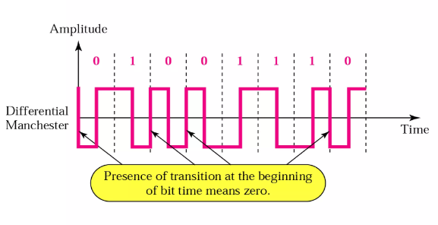

Slide 31
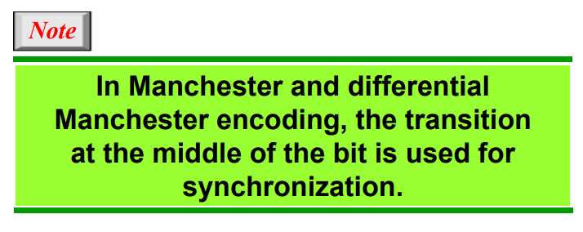

Slide 32
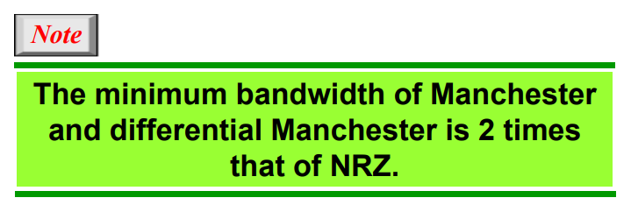

Slide 33
Bipolar Encoding
Sometimes called multilevel binary
Uses three voltage levels: positive, negative, and zero.
The voltage level for one data element is at zero, while the voltage level for the other element alternates between positive and negative.
Zero leve represents binary 0; 1s are represented with alternating positive and negative voltages even when the 1 bits are not consecutive.
Two variations of bipolar encoding
AMI(alternate mark inversion)
Pseudoternary

Slide 34
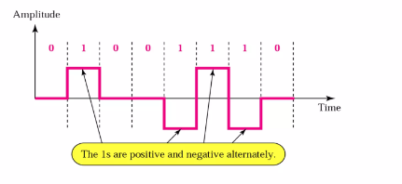
Bipolar-alternate mark inversion (AMI)
The word mark comes from the telegraphy and means 1
AMI means alternate 1 inversion
0- no line signal (neutral zero voltage)
1- represented by positive or negative level voltages alternating for successive ones.
Most recent preceding 1 bit has negative voltage negative
Notes:
A category of encoding techniques known as multilevel binary addresses some of the deficiencies of the NRZ codes. These codes use more than two signal levels. Two examples of this scheme was illustrated in Figure 5.2.
In the bipolar-AMI scheme, a binary 0 is represented by no line signal, and a binary 1 is represented by a positive or negative pulse. The binary 1 pulses must alternate in polarity. There are several advantages to this approach. First, there will be no loss of synchronization if a long string of 1s occurs. Each 1 introduces a transition, and the receiver can resynchronize on that transition. A long string of 0s would still be a problem. Second, because the 1 signals alternate in voltage from positive to negative, there is no net dc component. Also, the bandwidth of the resulting signal is considerably less than the bandwidth for NRZ. Finally, the pulse alternation property provides a simple means of error detection. Any isolated error, whether it deletes a pulse or adds a pulse, causes a violation of this property.

Slide 35
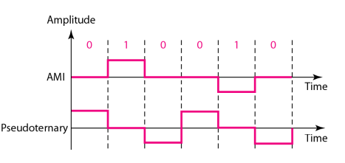
Multilevel Binary Pseudoternary
Same as AMI but
1- no line signal(neutral zero voltage)
0- alternating positive and negative level(voltage), alternating for successive zeros
Notes:
The comments on bipolar-AMI also apply to pseudoternary. In this case, it is the binary 1 that is represented by the absence of a line signal, and the binary 0 by alternating positive and negative pulses. There is no particular advantage of one technique versus the other, and each is the basis of some applications.

Slide 36
Other schemes
2B1Q(two binary, one quaternary) uses four voltage levels
One pulse can represent 2 bits; more efficient.

Slide 37
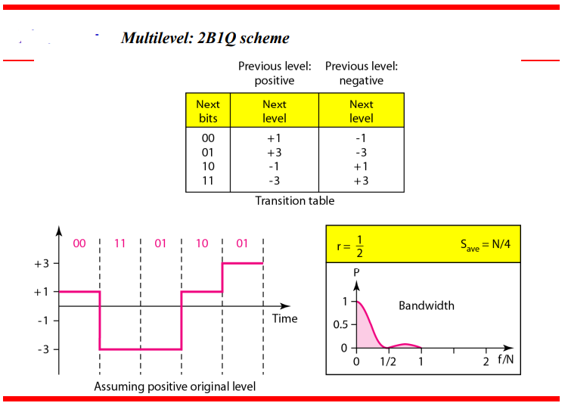

Slide 38
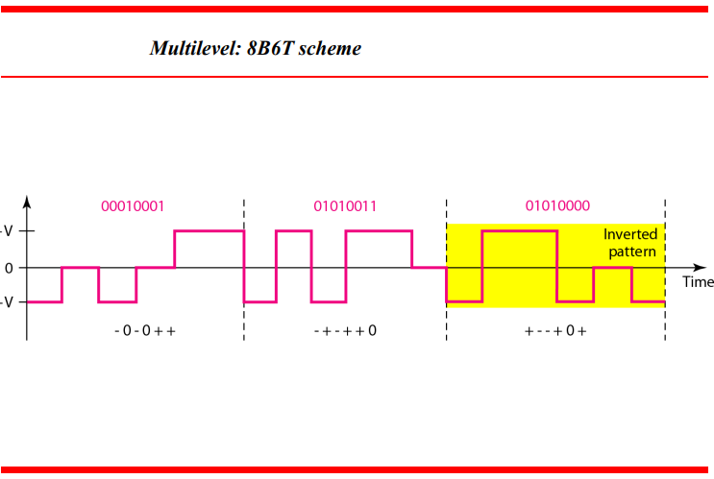

Slide 39
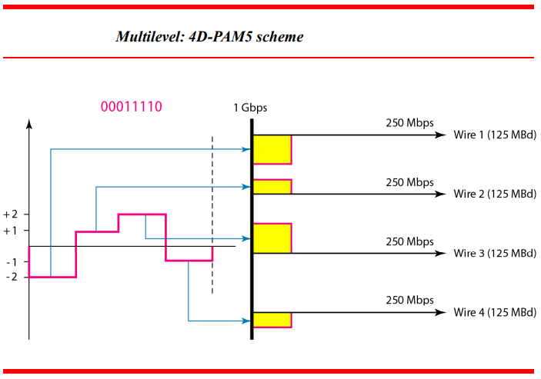

Slide 40
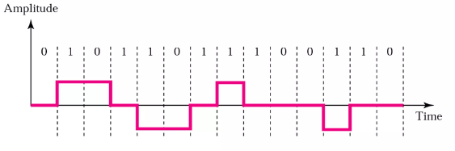
MLT-3(multi-line transmission, three level)- similar to NRZ-1 using three levels of signals; signal transitions occur at the beginning of 1 bit, no transition at the beginning of 0.

Slide 41
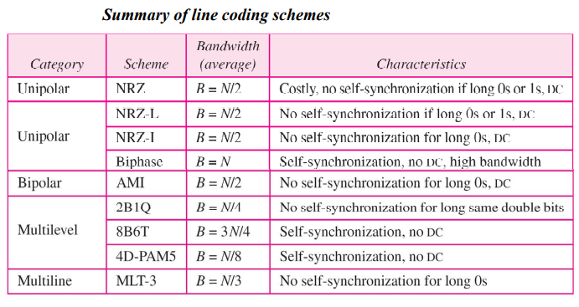

Slide 42
Block Coding
Coding method to ensure synchronization an detection of errors.
Block coding is represented by slash notation, mB/nB. Means, m-bit block is substituted with n-bit block where n > m.
Block coding involves three steps:
Division
Substitution
Combination.
After block coding is done, it is line coded for transmission.

Slide 43
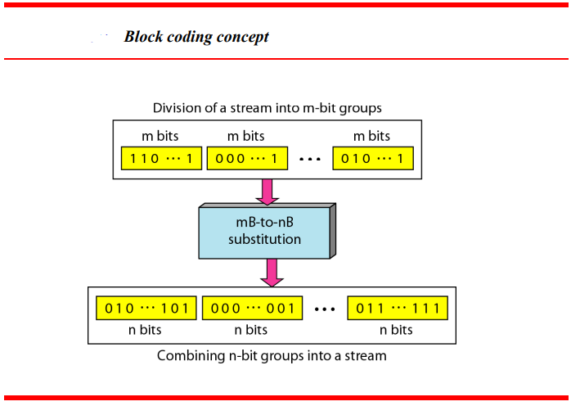
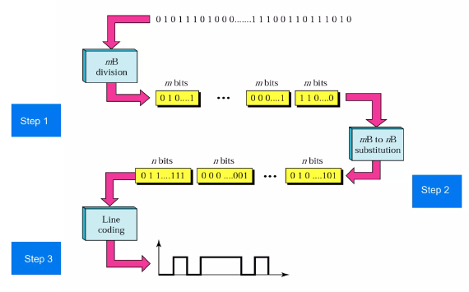

Slide 44
Transformation Steps
Step 1: bit stream is divided in to groups of m bits
Step 2: substitute an m-bit code for an n-bit group
Codes with no more than three consecutive 0’s or 1’s are used to achieve synchronization
Since only a subset of blocks are used, if one or more bits are changed and invalid code is received a reviver can easily detect the error
Step 3: line encoding scheme is the used to create a signal

Slide 45
Common block codes
4B/5B- every 4 bit of data is encoded into a 5 bit code; NRZ-1 is usually used for line coding
8B/10B- group of 8 bits of data is substituted by a 10 bit code
8B/6T- each 8 bit group is substituted with six symbol code; uses less bandwidth since three levels may be used

Slide 46
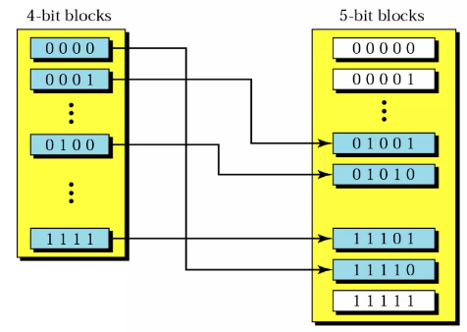

Slide 47
Analog-to-Digital Conversion
Microphones create analog voice and camera creates analog videos, which are treated as analog data.
To transmit this analog data over digital signals, we need analog to digital conversion.
Analog data is a continuous stream of data in the wave form whereas digital data is discrete.
To convert analog wave into digital data, we use Pulse Code Modulation (PCM).

Slide 48
Pulse Code Modulation (PCM)
PCM is one of the most commonly used method to convert analog data into digital form.
It involves three steps:
Sampling
Quantization
Encoding.

Slide 49
Sampling
Is the process of obtaining amplitudes of a signal at a regular interval
The analog signal is sampled every T interval.
Most important factor in sampling is the rate at which analog signal is sampled.
According to Nyquist Theorem, the sampling rate must be at least two times of the highest frequency of the signal.

Slide 50
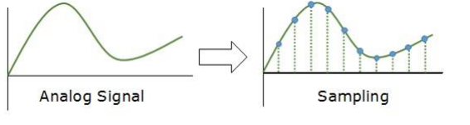

Slide 51
Quantization
Sampling yields discrete form of continuous analog signal. Every discrete pattern shows the amplitude of the analog signal at that instance.
The quantization is done between the maximum amplitude value and the minimum amplitude value.
Quantization is approximation of the instantaneous analog value.

Slide 52
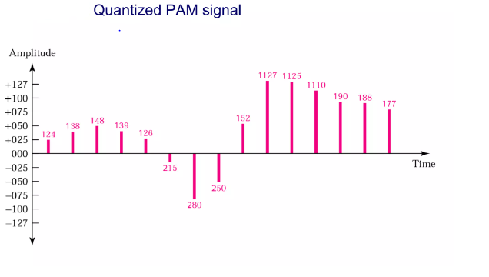
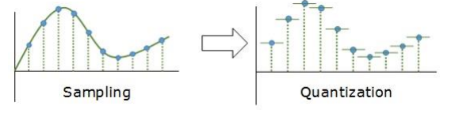

Slide 53
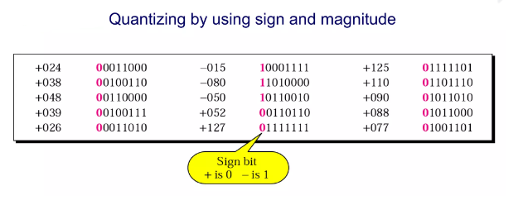

Slide 54
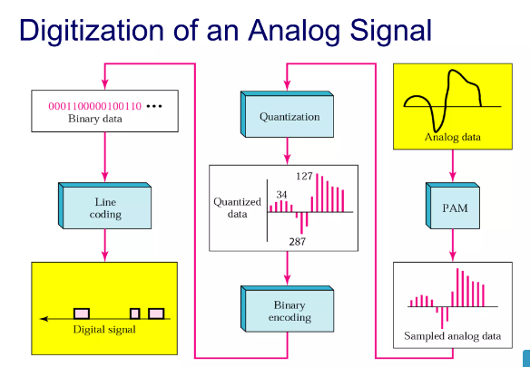

Slide 55
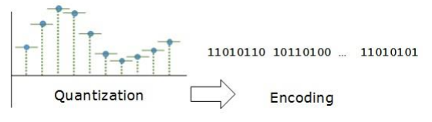
Encoding
In encoding, each approximated value is then converted into binary format.

Slide 56
Transmission Modes
The transmission mode decides how data is transmitted between two computers.
The binary data in the form of 1s and 0s can be sent in two different modes: Parallel and Serial.

Slide 57
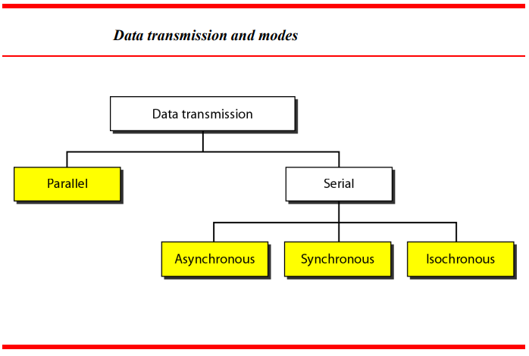

Slide 58
Parallel Transmission
Bits in a group are sent simultaneously, each using a separate link
n wires are used to send n bits at one time
Advantage : speed
Disadvantage: cost; limited to short distance

Slide 59
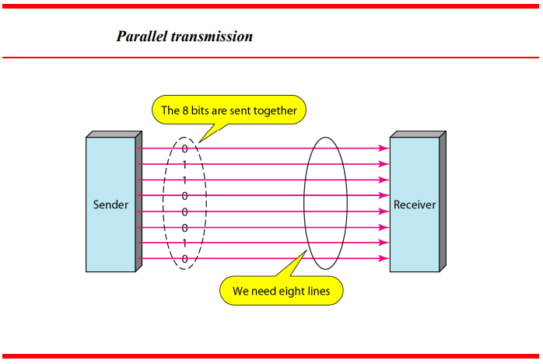

Slide 60
Serial Transmission
Transmission of data one bit at a time using only one single link
Advantage: reduced cost
Disadvantage: requires conversion device
Methods
Asynchronous
synchronous.

Slide 61
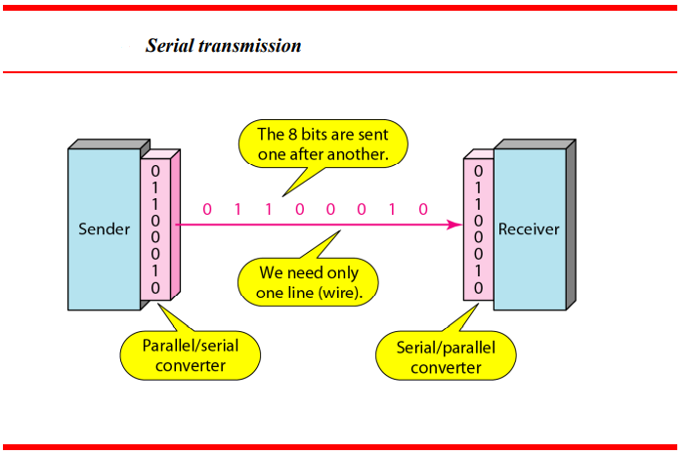

Slide 62
Asynchronous Serial Transmission
It is named so because there is timing is not important.
Transfer of data with start bit and stop bits and a variable time interval(gap) between data unites
Start bit alerts receiver that new group of data is arriving
Stop bits alert receiver that byte is finished
Synchronization achieved through start/stop bits with each byte received

Slide 63
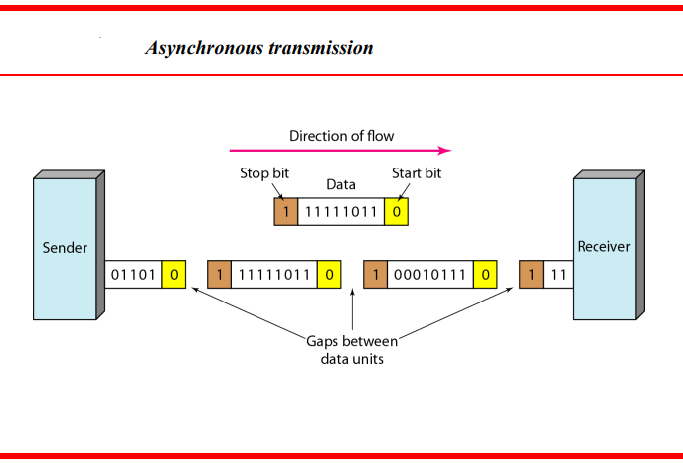

Slide 64
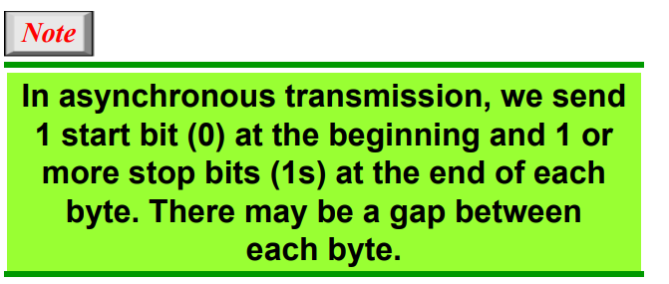

Slide 65
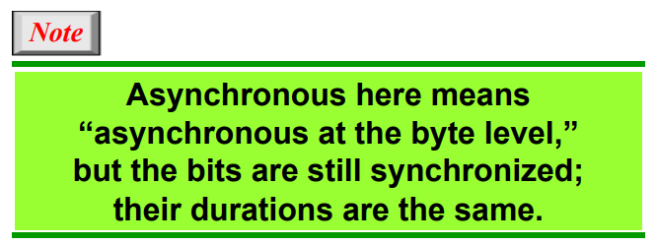

Slide 66
Requires additional overhead(stop/start bits)
Slower
Cheap and effective
Ideal for low-speed communication when gaps may occur during transmission(ex. Keyboard)

Slide 67
Synchronous Serial Transmission
Data bits are sent in burst mode without maintaining gap between bytes (8- bits). Single burst of data bits may contain a number of bytes.
Timing in synchronous transmission has importance as there is no mechanism followed to recognize start and end data bits.
It is up to the receiver to recognize and separate bits into bytes.
Advantage: high speed, and it has no overhead of extra header and footer bits as in asynchronous transmission.
Byte synchronization is accomplished by data link layer

Slide 68
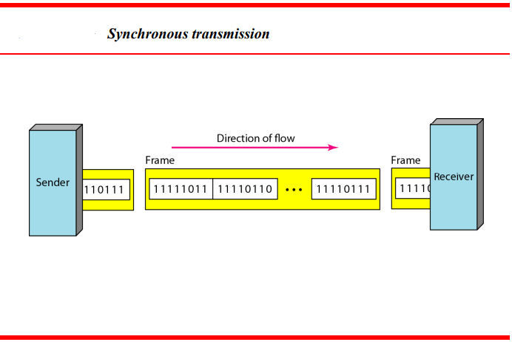

Slide 69
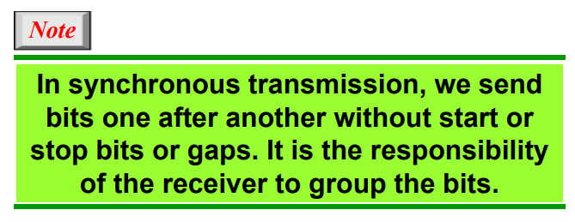

Slide 70
Isochronous
A sequence of events is isochronous if the events occur regularly, or at equal time intervals. The isochronous transmission guarantees that the data arrive at a fixed rate.
In real-time audio and video, in which uneven delays between frames are not acceptable, synchronous transmission fails. For example, TV images are broadcast at the rate of 30 images per second; they must be viewed at the same rate.

Slide 71
If each image is sent by using one or more frames, there should be no delays between frames. For this type of application, synchronization between characters is not enough; the entire stream of bits must be synchronized. The isochronous transmission guarantees that the data arrive at a fixed rate.

Slide 72
Reference
Data communications and networking 5th edition by Behrouz a. Fourouzan

